Slide 1
Presentation on Outliers Analysis
Machine learning & Data mining

Slide 2
Presented to- Dr. Md. Jamshed Alam Patwary Assistance Professor Dept of CSE | Presented by- Afra Binth Osman (C173229) Faria Tabassum Nabila (C173227) Amena Akter Juhi (C173226) Dilsahd Nur Mustafa(C173212) Maleeha Zarin(C173211)

Slide 3
01
02
TABLE OF CONTENTS
03
04
Introduction
Detect Outlier
Remove Outlier
Hands on implementation

Slide 4
01
Introduction

Slide 5
What is Outlier
Causes and effects
Types of Outlier

Slide 6
What is Outliers?
A data object that deviates significantly from the normal objects as if it were generated by a different mechanism
Ex: Unusual credit card purchase
Outliers are different from the noise data-
Noise is random error or variance in a measured variable
Noise should be removed before outlier detection
It may help hide outliers and reduce the effectiveness of outlier detection.

Slide 7
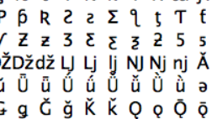
The Basic Difference of outlier and noise
An outlier is not a false value but void in meaning. It is definite and accurate but when it is linked with the other tuples in your model, it is just not in the same range.
Whereas, Noise is garbage. Void, Null information that is not useful at all, under any circumstances. Data Sets have those too.
Let’s say there are 2 columns in your data set. “Profession and Income”. And they have about a hundred thousand records. Out of these 100,000 let’s say 50 are of the type where the profession is listed correctly, but the Income column has terms like “cake”, “pastry”, “hello kitty” or “Pikachu” etc. or let’s say during transmission these 50 records failed and transmitted partially or while conversion from a .csv/.xls form they somehow lost their initial value and now display some garbage literals like these
Example: In a 50–100 people Average annual income/assets classifier if you include Bill Gates then automatically everyone in that study becomes a millionaire on an average. This will almost certainly lead to a high value of false-positives and false-negatives.

Slide 8
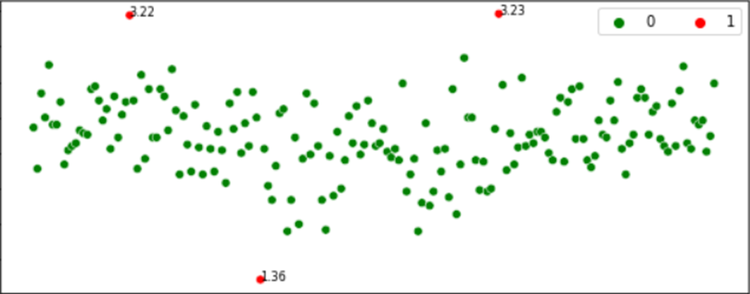
Outliers are the values that look different from the other values in the data. Above is a plot highlighting the outliers in ‘red’ and outliers can be seen in both the extremes of data.

Slide 9
Causes of outliers on a data set:
Measurement Error
Data Entry Error
Experimental Error
Data Processing Error
Sampling Error
Intentional Outlier.
Natural Outlier

Slide 10
Effects of outliers on a data set:
If the outliers are non-randomly distributed, they can decrease normality.
It increases the error variance and reduces the power of statistical tests.
They can cause bias and/or influence estimates.
They can also impact the basic assumption of regression as well as other statistical models.

Slide 11
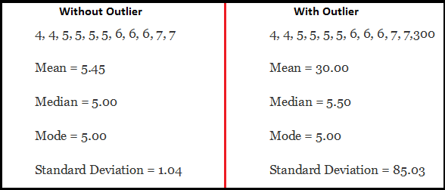
Lets see an example of the impact of Outliers
Data set with outliers has significantly different mean and standard deviation. In the first scenario, we will say that average is 5.45. But with the outlier, average soars to 30. This would change the estimate completely.
11

Slide 12
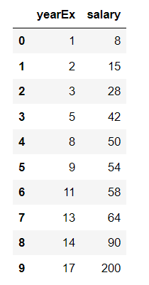
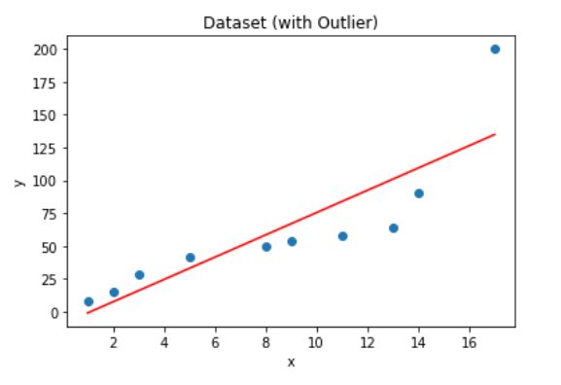
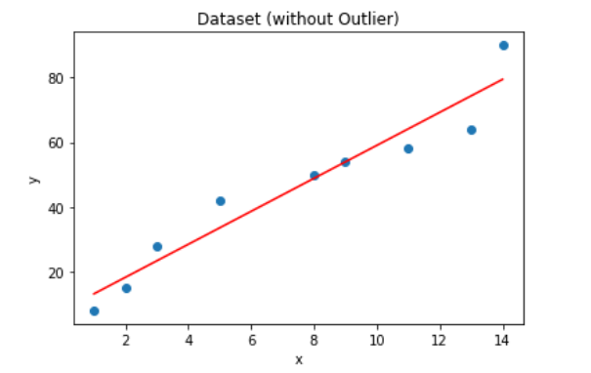
Here the dataset contains the salary of employee according to their job experience

Slide 13
Types of outliers
Outliers
Ex: Intrusion detection in Computer Network
Contextual/ Conditional
Collective
Global/Point
Ex: Temperature
Intrusion Detection

Slide 14
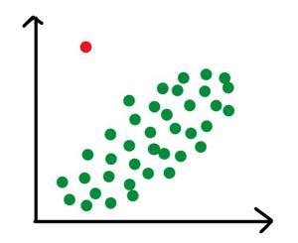
Point or global Outliers:
A data point is considered a global outlier if its value is far outside the entirety of the data set in which it is found.
For Example:
In a class all student age will be approx. similar, but if see a record of a student with age as 100. It’s an outlier. It could be generated due to various reasons.

Slide 15
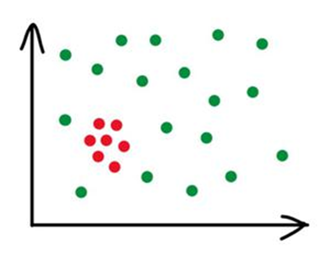
Collective Outliers
if in a given dataset, some of the data points, as a whole, deviate significantly from the rest of the dataset, they may be termed as collective outliers.
For Example:
Every one of your neighbors moving out of the neighborhood on the same day is a collective outlier because although it's definitely not rare that people move from one residence to the next, it is very unusual that an entire neighborhood relocates at the same time.

Slide 16
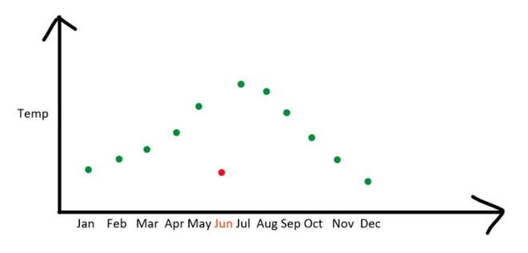
Contextual (Conditional) Outliers
Observations considered anomalous given a specific context. A data point is considered a contextual outlier if its value significantly deviates from the rest of the data points in the same context.
For Example:
A temperature reading of 40°C may behave as an outlier in the context of a “winter season” but will behave like a normal data point in the context of a “summer season”.

Slide 17
02
Detection of Outliers

Slide 18
Challenges of Outlier Detection
Outliers Detection Methods

Slide 19
Challenges of Outlier Detection
Modeling normal objects and outliers properly
Application-specific outlier detection
Handling noise in outlier detection
Understandability

Slide 20
Outliers Detection Methods
Unsupervised
Supervised
Semi-Supervised
Statistical
Clustering
Proximity
Parametric
Non-Parametric
Distance- Based
Density -
Based
Histogram
DBSCAN
LOF
(Local Outlier Factor)
Standard-Deviation
Kernel Density estimation
Z- Score
Inter-Quartile Range (IQR)
K-means
Classification
One class model
Do not belong any cluster
Distance to the closet cluster
Statistical,
Proximity-based &
Clustering-Based
Supervised,
Unsupervised &
Semi-Supervised

Slide 21
03
Detect and Remove Outliers

Slide 22
Visualization Methods
Statistical Methods
Proximity based method

Slide 23
Visualization Methods
Using Box Plot
Captures the summary of the data effectively and efficiently with only a simple box and whiskers. Boxplot summarizes sample data using 25th, 50th, and 75th percentiles. One can just get insights(quartiles, median, and outliers) into the dataset by just looking at its boxplot.
Using Scatter Plot
It is used when you have paired numerical data, or when your dependent variable has multiple values for each reading independent variable, or when trying to determine the relationship between the two variables. In the process of utilizing the scatter plot, one can also use it for outlier detection.

Slide 24
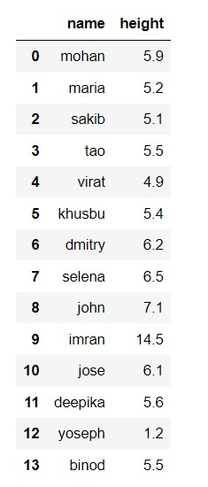
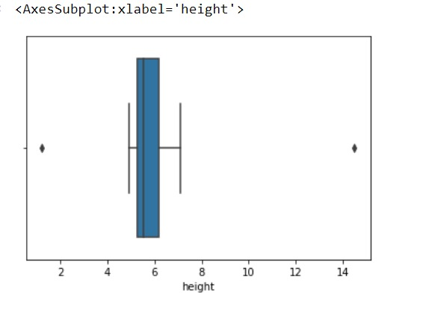
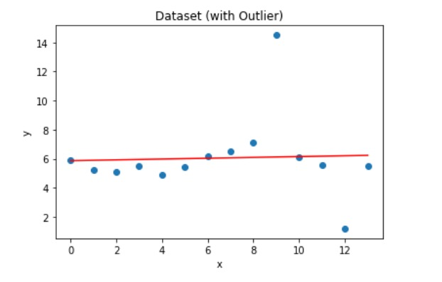
Example
Box Plot
Scatter Plot
24

Slide 25
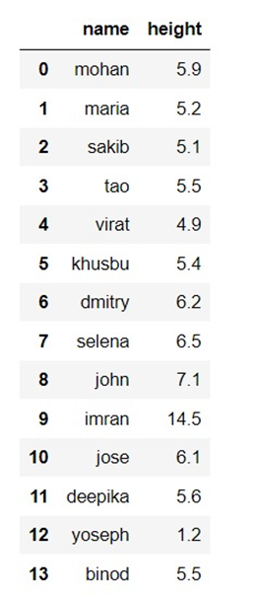
Statistical Methods
Percentile method
Percentile are the values that divide data set into 100 equals part. It indicate the location of a score in a distribution.
This technique works by setting a particular threshold value, which decides based on our problem statement.
Numerical Example:
Find the number in the following set of data where 5% of values fall below it, and 95% fall above.

Slide 26
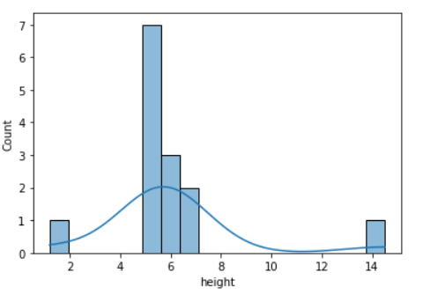
STEP-1:
Order the data from smallest to largest(ascending order)
1.2, 4.9, 5.1, 5.2, 5.4, 5.5, 5.5, 5.6, 5.9, 6.1, 6.2, 6.5, 7.1, 14.5
STEP-2:
This particular data set has n=14 items
STEP-3:
Converting percentage to a decimal for “q”.so , q1=0.05 and q2= 0.95
STEP-4:
Now applying ith observation = q (n + 1)
For 1st observation,
q1(n + 1)
= 0.05(14+1)
= 0.75
~ 1(round down to 1)
For 2nd observation,
q2(n + 1)
= 0.95(14+1)
= 14.25
~ 14(round down to 14)
The 1st number in the set is 1.2, which is the number where 5%of the values fall below it and
The 14th number in the set is 14.5 which is the number where 95% of the values fall above it.
26

Slide 27
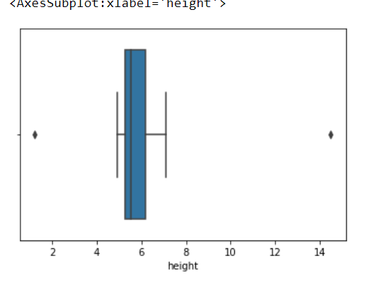
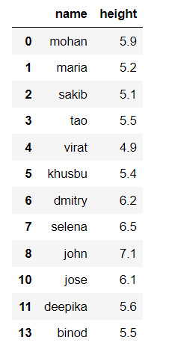
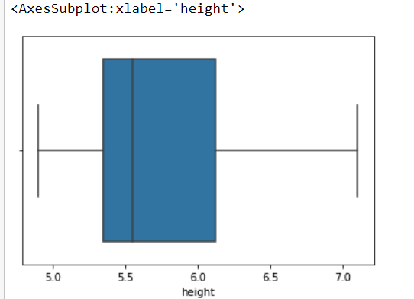
STEP-5:
The 1st number in the set is 1.2,
The 14th number in the set is 14.5
Consider as outliers . So we have to remove these
data
Remove
Outlier
With Outlier
Without Outlier
27

Slide 28
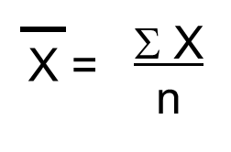
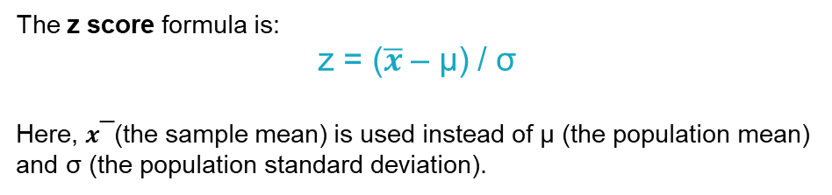
Z-Score method
Z-score method is another method for detecting outliers. It can be placed on a normal distribution curve.
The z score formula is:
z = ($\overline{x}$ – μ) / σ
Here, 𝒙 ̅ (the sample mean) is used instead of μ (the population mean) and σ (the population standard deviation).

Slide 29
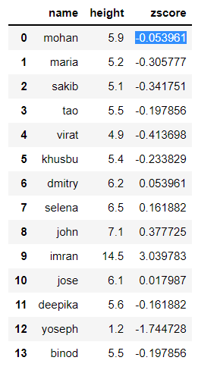
Numerical Example(Z-Score):
Here we applied Z-Score on same data set for detecting outliers
STEP-1:
we have to find mean value and standard deviation value
According to the data set,
X= height
μ = 6.05
σ = 2.78
STEP-2:
Putting the mean, μ, into the z-score equation.
For X= 5.9 the z score becomes,
Z = (5.9-6.05)/2.779
= -0.053961
Similarly, calculate z-score for all objects

Slide 30
STEP-3:
Now putting those values into (-3 < Z-scores < 3) range:
Here the outlier becomes,
 | name | height | zscore
9 | imran | 14.5 | 3.039783
STEP-4:
Then we have to remove this outliers.
30

Slide 31
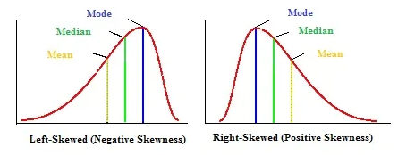
IQR method
Used when our data distribution is skewed
If one tail is longer than other , the distribution is skewed
The formula for calculating the interquartile range takes the third quartile(Q3) value and subtracts the first quartile(Q1) value.
IQR = Q3 – Q1
Equivalently, the interquartile range is the region between the 75th and 25th percentile (75 – 25 = 50% of the data).
Using the IQR formula, we need to find the values for Q3 and Q1..
31

Slide 32
Numerical Example(IQR):
Here we worked on same data set for detecting outliers
STEP-1:
Order the data from smallest to largest(ascending order)
1.2, 4.9, 5.1, 5.2, 5.4, 5.5, 5.5, 5.6, 5.9, 6.1, 6.2, 6.5, 7.1, 14.5
STEP-2:
Now applying ith observation = q (n + 1)
For 1st observation,
q1(n + 1)
= 0.25(14+1)
= 3.75
~ 4(round down to 4)
For 2nd observation,
q3(n + 1)
= 0.75(14+1)
= 11.25
~ 11(round down to 11)
STEP-3:
IQR = q3-q1
= 11th – 4th
= 6.2 – 5.2
= 1
32

Slide 33
STEP-4:
Hence,
Lower outlier limit = Q1 − 1.5 * IQR
= 5.2 -1.5*1
= 3.7
Upper outlier limit = Q3 + 1.5 * IQR
= 6.2 + 1.5*1
= 7.7
STEP-5:
The value less then 3.7 are outlier also the value upper then 7.7 are outlier.
STEP-6:
Remove previously detected outliers in our data set
33

Slide 34
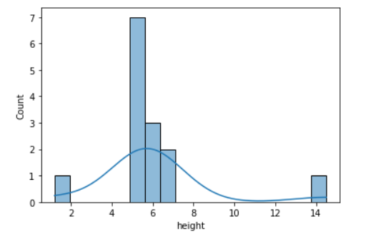
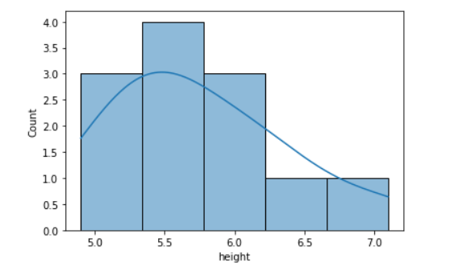
With Outlier
Without Outlier

Slide 35
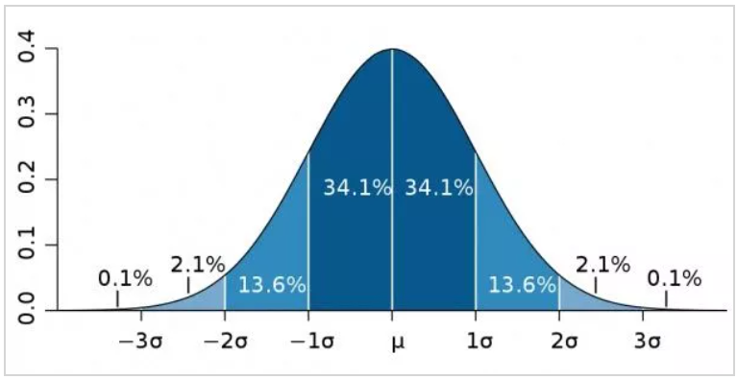
Standard Deviation method
Use empirical relations of Normal distribution.
The data points which fall below μ -3*(σ) or above μ +3*(σ) are outliers.
Numerical Example:
Here we worked on same data set for detecting outliers
STEP-1:
We have to find mean value and standard deviation value
According to the data set,
Mean, μ = 6.05
Standard Deviation, σ = 2.78
35

Slide 36
STEP-2:
Hence,
Lower outlier limit = μ -3*(σ)
= 6.05 -1.5*2.78
= 1.88
Upper outlier limit = μ +3*(σ)
= 6.05 +1.5*2.78
= 10.22
STEP-3:
The value less then 1.88 are outlier also the value upper then 10.22 are outlier.
STEP-4:
Remove outliers in our data set
36

Slide 37
04
Density Based Outlier Detection

Slide 38
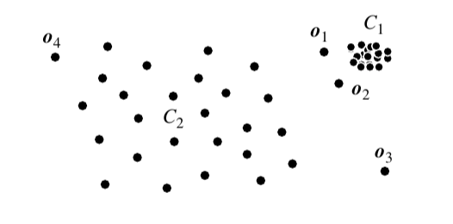
Local Outlier Factor (LOF)
Density-based outlier detection method
Unsupervised anomaly detection method
Why need density based approach?
Consider the example above, distance-based methods are able to detect o3, but as for o1 and o2 it is not as evident.
This method investigates the density of an object and that of its neighbors. Here, an object is identified as an outlier if its density is relatively much lower than that of its neighbors.

Slide 39
Local Outlier Factor (LOF)
What does the local outlier mean?
When a point is considered as an outlier based on its local neighborhood, it is a local outlier. LOF will identify an outlier considering the density of the neighborhood. LOF performs well when the density of the data is not the same throughout the dataset
To understand LOF, we have to learn a few concepts sequentially:
K-distance and K-neighbors
Reachability Distance (RD)
Local Reachability Density (LRD)
Local Outlier Factor (LOF)

Slide 40
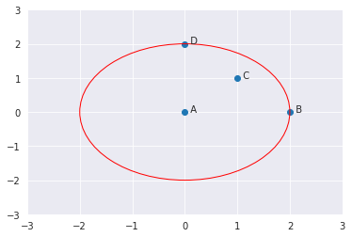
K-DISTANCE AND K-NEIGHBORS
K-distance is the distance between the point, and it’s Kᵗʰ nearest neighbor
K-neighbors includes a set of points that lie in or on the circle of radius K-distance. Denoted by Nₖ(A). K-neighbors can be more than or equal to the value of K
K-distance of A with K=2
If K=2, K-neighbors of A -> C, B, D.
Here, the value of K=2 but the ||N₂(A)|| = 3.

Slide 41
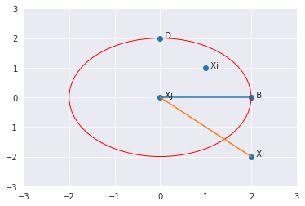
Reachability Distance (RD)
It is defined as the maximum of K-distance of Xj and the distance between Xi and Xj.
if a point Xi lies within the K-neighbors of Xj, the reachability distance will be K-distance of Xj (blue line), else reachability distance will be the distance between Xi and Xj (orange line)

Slide 42

LOCAL Reachability Density (LRD)
LRD is inverse of the average reachability distance of A from its neighbors.
According to LRD formula, more the average reachability distance (i.e., neighbors are far from the point), less density of points are present around a particular point.
This tells how far a point is from the nearest cluster of points. Low values of LRD implies that the closest cluster is far from the point.

Slide 43

Local Outlier Factor(LOF)
LOF is the ratio of the average LRD of the K neighbors of A to the LRD of A
If the point is not an outlier, the ratio of average LRD of neighbors is approximately equal to the LRD of a point (because the density of a point and its neighbors are roughly equal). In that case, LOF is nearly equal to 1.
On the other hand, if the point is an outlier, the LRD of a point is less than the average LRD of neighbors. Then LOF value will be high.

Slide 44
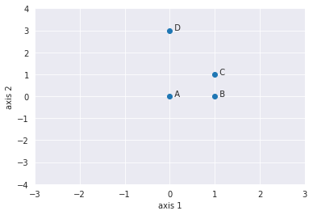
Numerical Example
4 points: A(0,0), B(1,0), C(1,1) and D(0,3) and K=2. We will use LOF to detect one outlier among these 4 points.

Slide 45

First, calculate the K-distance, distance between each pair of points,
The distance can be measured by various techniques.
Ex: Euclidean, Manhattan, etc.
We will be using Manhattan distance as a measure of distance.
Formula :
The Manhattan Distance between two points (X1, Y1) and (X2, Y2) is
A(0,0), B(1,0), C(1,1) and D(0,3)
Manhattan Distance (A,B) | |0-1| +|0-0| | 1
Manhattan Distance (A,C) | |0-1| +|0-1| | 2
Manhattan Distance (A,D) | |0-0| +|0-3| | 3
Manhattan Distance (B,C) | |1-1| +|0-1| | 1
Manhattan Distance (B,D) | |1-0| +|0-3| | 4
Manhattan Distance (C,D) | |1-0| +|1-3| | 3

Slide 46
The K-distances are,
Distance (A,B) | 1
Distance (A,C) | 2
Distance (A,D) | 3
K-distance(A) ->
since C is the 2ᴺᴰ nearest neighbor of A
-> distance(A, C) =2
K-distance(B) ->
since A, C are the 2ᴺᴰ nearest neighbor of B
-> distance(B,C) OR distance(B,A) = 1
K-distance(C) ->
since A is the 2ᴺᴰ nearest neighbor of C
-> distance(C,A) =2
K-distance(D) ->
since A,C are the 2ᴺᴰ nearest neighbor of D
-> distance(D,A) or distance(D,C) =3
Distance (B,A) | 1
Distance (B,C) | 1
Distance (B,D) | 4
Distance (C,B) | 1
Distance (C,A) | 2
Distance (C,D) | 3
Distance (D,A) | 3
Distance (D,C) | 3
Distance (D,B) | 4
46

Slide 47
Then find K-neighborhood of all the points with K=2.
K-neighborhood (A) = {B,C} , ||N2(A)|| =2 K-neighborhood (B) = {A,C}, ||N2(B)|| =2 K-neighborhood (C)= {B,A}, ||N2(C)|| =2 K-neighborhood (D) = {A,C}, ||N2(D)|| =2
Second, Calculate RD of neighborhood by using the k-distance and the distance e
RD(A.B) = | Max { k-distance(B), distance(A,B) } | = Max(1,1) = 1
RD(A.C)= | Max { k-distance(C), distance(A,C) } | = Max(2,2) = 2
RD(B,A)= | Max { k-distance(A), distance(B,A) } | = Max(2,1) = 2
RD(B,C)= | Max { k-distance(C), distance(B,C) } | = Max(2,1) = 2
RD(C,A)= | Max { k-distance(A), distance(C,A) } | = Max(2,2) = 2
RD(C,B)= | Max { k-distance(B), distance(C,B) } | = Max(1,1) = 1
RD(D,A)= | Max { k-distance(A), distance(D,A) } | = Max(2,3) = 3
RD(D,C)= | Max { k-distance(A), distance(D,C) } | = Max(2,3) = 3
47

Slide 48
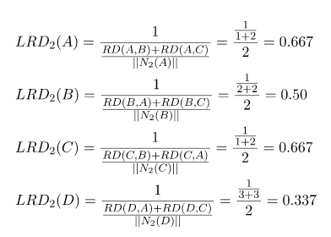
Reachability Distance, and K-neighborhood will be used to calculate Local Reachability Density(LRD)
48

Slide 49
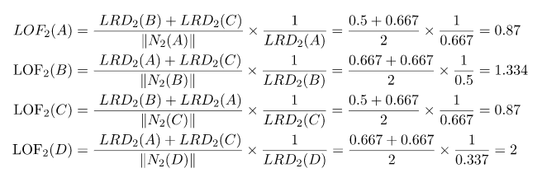
Finally, Local reachability density (LRD) will be used to calculate the Local Outlier Factor (LOF).
Highest LOF among the four points is LOF(D). Therefore, D is an outlier.
49

Slide 50
ADVANTAGES OF LOF
A point will be considered as an outlier if it is at a small distance to the extremely dense cluster. The global approach may not consider that point as an outlier. But the LOF can effectively identify the local outliers.
Therefore, It gives better results than the global approach to find outliers.
DISADVANTAGES OF LOF
Since LOF is a ratio, it is tough to interpret. There is no specific threshold value above which a point is defined as an outlier. The identification of an outlier is dependent on the problem and the user.
50

Slide 51
REFERENCES
Breunig, M. M., Kriegel, H. P., Ng, R. T., and Sander, J. (2000). LOF: identifying density-based local outliers. In ACM sigmod record (Vol. 29, №2, pp. 93–104). ACM
https://towardsdatascience.com/density-based-algorithm-for-outlier-detection-8f278d2f7983
https://www.mygreatlearning.com/blog/what-is-outlier-detection/
https://www.sciencedirect.com/science/article/pii/B9780123814791000125

Slide 52
05
Hands On implementation

Slide 53
Outliers Detection for small dataset
Outliers Detection for large dataset (House Price Dataset)
Compare Baseline Model Performance and Performance after removing outliers.
Comparison among Four Automatic Outlier detection methods based on house price data
Comparison between Statistical Methods and Automatic Detection methods based on house price data.
Result Analysis

Slide 54
Implementation of Different Outlier Detection Methods for simple dataset
Implementation of Percentile Method
Implementation of IQR Method
Implementation of Z-Score Method
Implementation of Standard Deviation Method
Implementation of density based Method

Slide 55
Implementation of Automatic Outlier Detection Methods for large dataset
Local Outlier Factor
Isolation Forest
Minimum Covariance Determinant
One-Class SVM
Applied above mentioned algorithm on House Price Dataset. Also applied the statistical methods

Slide 56
THANKS
DOES ANYONE HAVE ANY QUESTIONS?
Please keep this slide for attribution

